Slide 1

Assessing Policy Options for Effective Greenhouse Gas Emission Reduction In Turkey
A Comparative Analysis
Policy Paper Presentation
Akay Kaan Kadioglu (SNR: 2070789)
Skills: Visualizing Data & Writing for Policy Makers
Notes:
Renewable Energy in Turkey: OpenAI. (2024). An aerial view of a wind farm near the coast in Turkey with a Turkish flag [Digital image]. Retrieved from OpenAI.

Slide 2



Structure
Background
Policy Options
Recommendation

Slide 3

Background

Slide 4
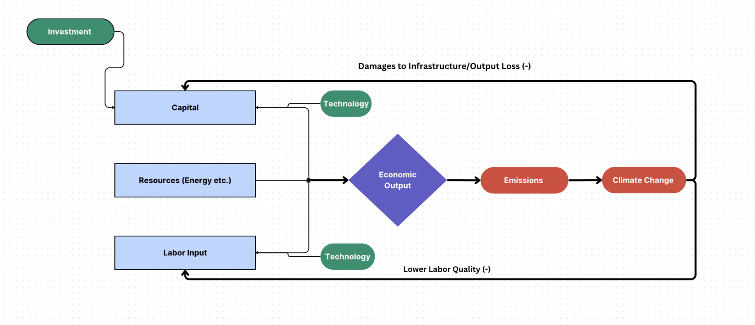
Why Reduce Emissions?

Slide 5
Decoupling Economic Growth From Emissions
Decoupling carbon emissions from economic output is a very large component of fighting climate change.
But how?

Slide 6
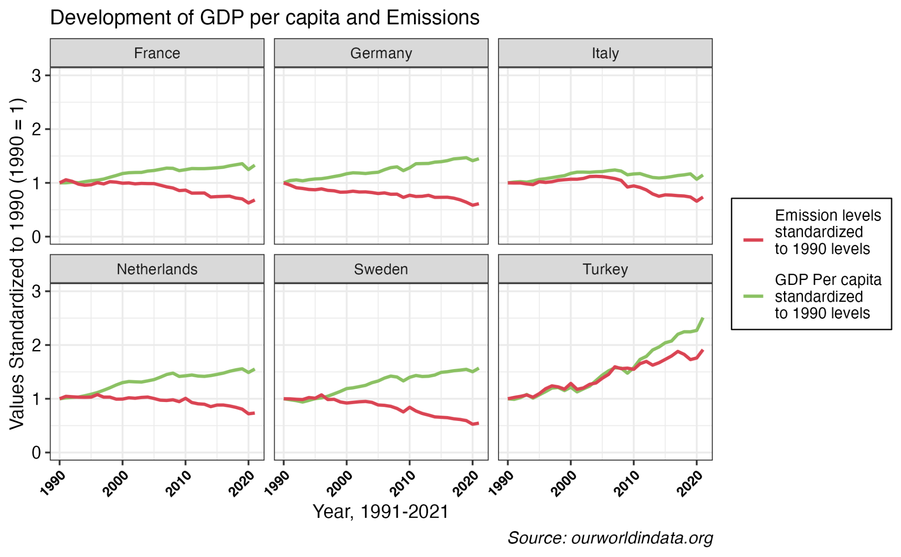
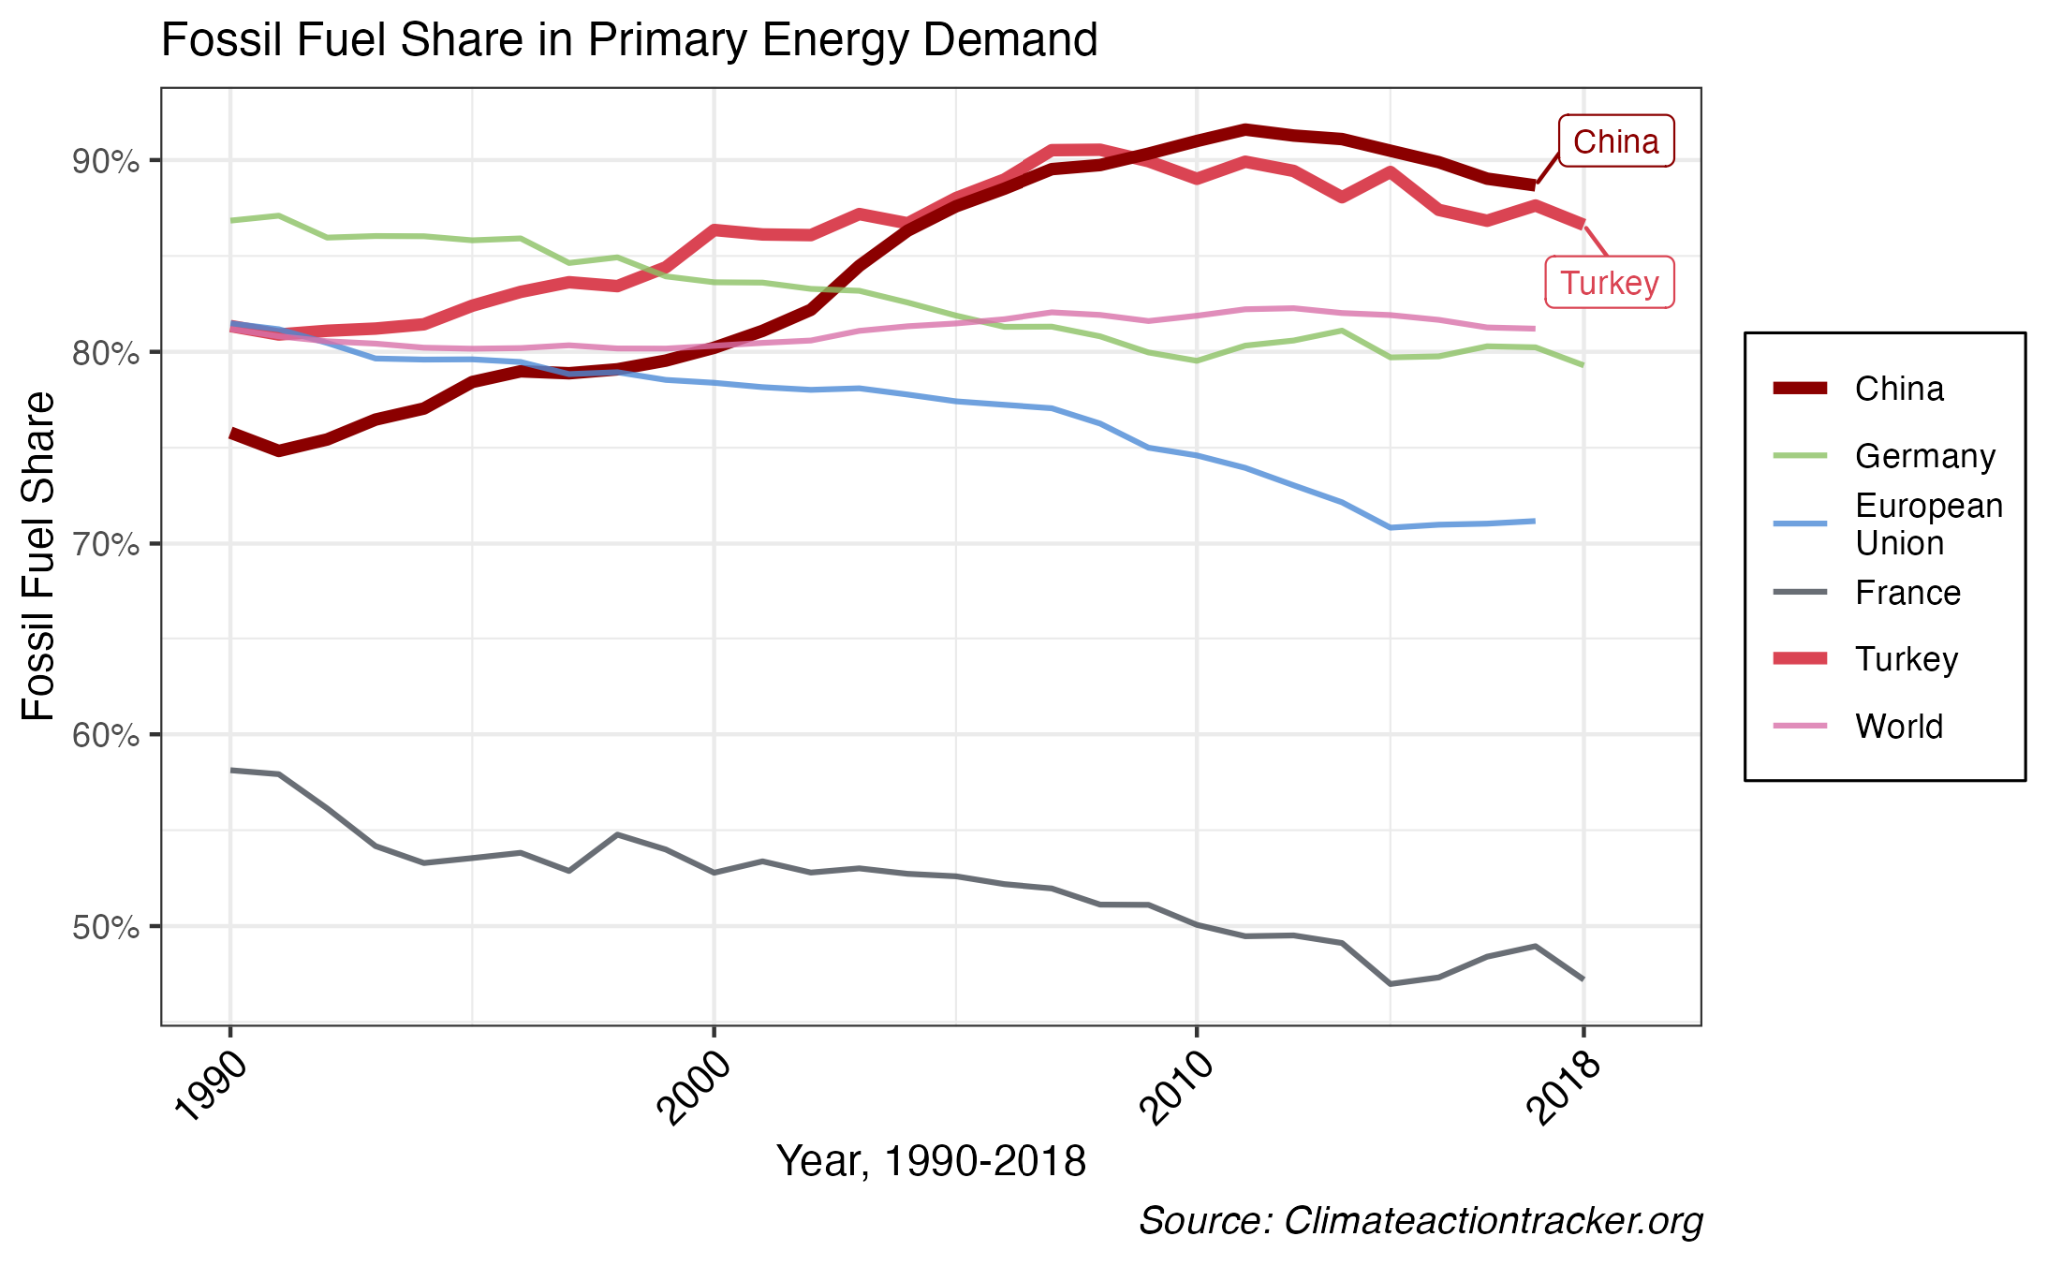
Decoupling outlook for Turkey

Slide 7
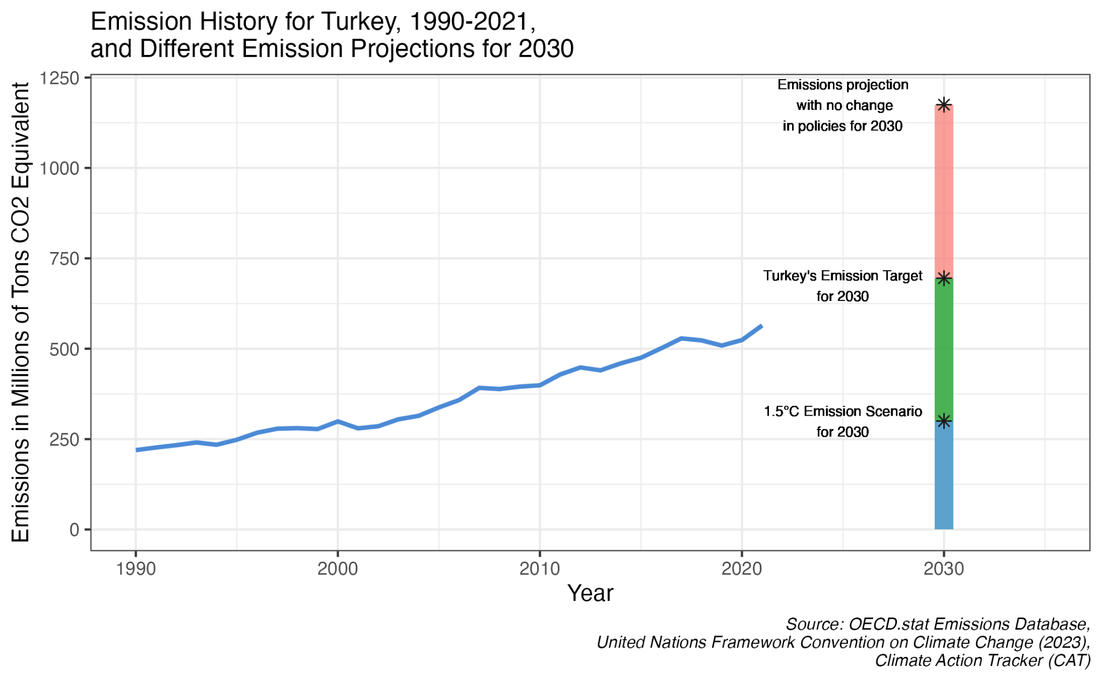

Emission Trends for Turkey
1- No Change in Policies
2- Turkey’s Emission Target
3- Goals for Paris Agreement

Slide 8

Policy Options

Slide 9

Green Finance
Financing green outcomes by green financial products such as:
Nature-linked securities
Green investment funds
Sustainability investment indices
Restructuring the financial sector in Turkey.
Sustainability Indices
Turkey: BIST Sustainability Index

Slide 10
Green Finance

Slide 11


Green Finance
Least regressive of all policies.
Establishes large amounts of capital required for green transition.
Incentivizes companies to invest sustainably, acts as a standard.
Politically feasible.
Long time horizon of implementation.
Transaction costs - requires constant monitoring.
Does not impact the input directly.

Slide 12
“Command-and-Control” Approach
Performance standards: The product meeting efficiency standards.
Fuel economy standards
Clean energy standards
Zero emission vehicle standards
Technology mandates: Mandating efficient, green technology in production.
Install energy efficient equipment for production
Green vehicles for transport
Sustainable sourcing of materials
Low-emission materials
Waste reduction and recycling

Slide 13
“Command-and-Control” Approach

Slide 14
“Command-and-Control” Approach
Politically feasible from the consumer side.
Still less regressive than carbon pricing.
Might promote renewable technology.
Lacks market flexibility.
Firms not completely charged.
Difficult to tailor specific needs to different firms.
Central authority approach, requires government discretion.
Example: CAFE standards in the U.S.

Slide 15
Carbon Pricing Instruments
Addresses externalities (emissions) in production by putting a price on per ton of CO2e emitted.
Makes greener alternatives more competitive such as solar, wind etc.
Policies such as: Emission trade mechanism, carbon tax, subsidies for emission reduction.

Slide 16
Carbon Pricing Instruments

Slide 17
Carbon Pricing Instruments
The policy directly addresses a key component of the production model.
Effective in the short-term.
Most efficient, directly address input composition.
Incentivizes firms to use green energy and technology in production.
Politically least feasible.
Most regressive, consumers receive the main adversities of carbon pricing.
International competitiveness concern, exports more expensive.
Notes:
A notable case, as provided by the report (2021), is with the implementation of strict carbon pricing to the electricity sector of the UK. Due to implementation of carbon pricing, increasing the effective carbon rate in the electricity sector from 7 EUR per ton of CO2 in 2012 to 36 EUR per ton of CO2 in 2018, emissions in the electricity sector dropped by 73% in the span of six years.

Slide 18

Recommendation

Slide 19
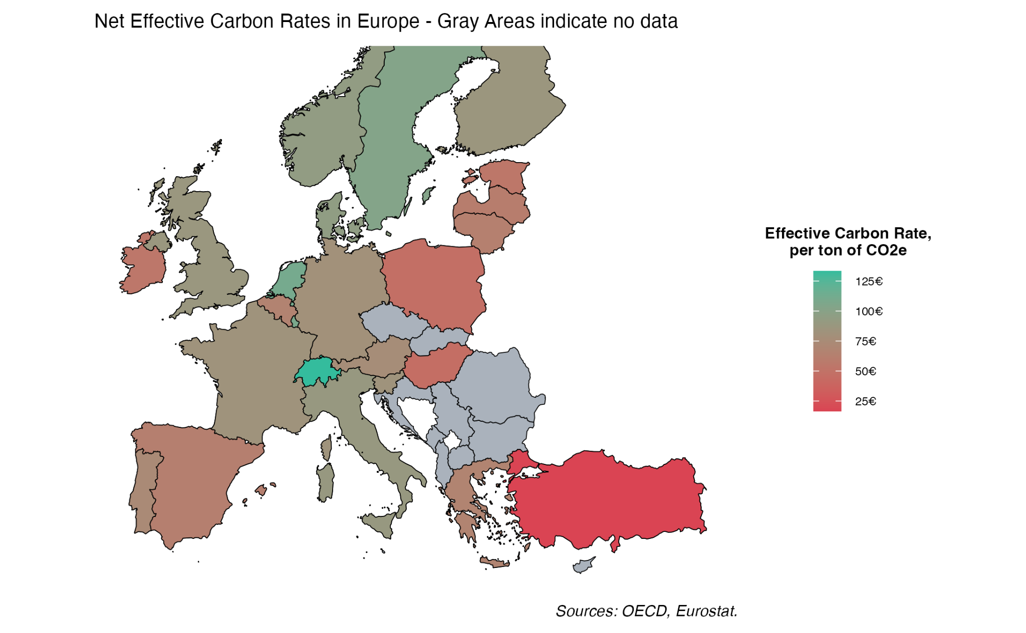
Suitability
Promising policy horizon, opportunities not exploited yet.
No active carbon pricing implemented.
Low net effective carbon rates due to coal subsidies and lack of carbon pricing.

Slide 20


Recommendation: Implement Carbon Pricing
Most effective policy for a time constrained problem
Example: UK
Addresses the key economic drivers directly.
Raises revenue that can address downsides (Regressive impact, international competitiveness)
With transparency of funds - Politically feasible
Notes:
A notable case, as provided by the report (2021), is with the implementation of strict carbon pricing to the electricity sector of the UK. Due to implementation of carbon pricing, increasing the effective carbon rate in the electricity sector from 7 EUR per ton of CO2 in 2012 to 36 EUR per ton of CO2 in 2018, emissions in the electricity sector dropped by 73% in the span of six years.

Slide 21
Thank you for your attention!

